Slide 1
Precision forestry in Sweden

Slide 2
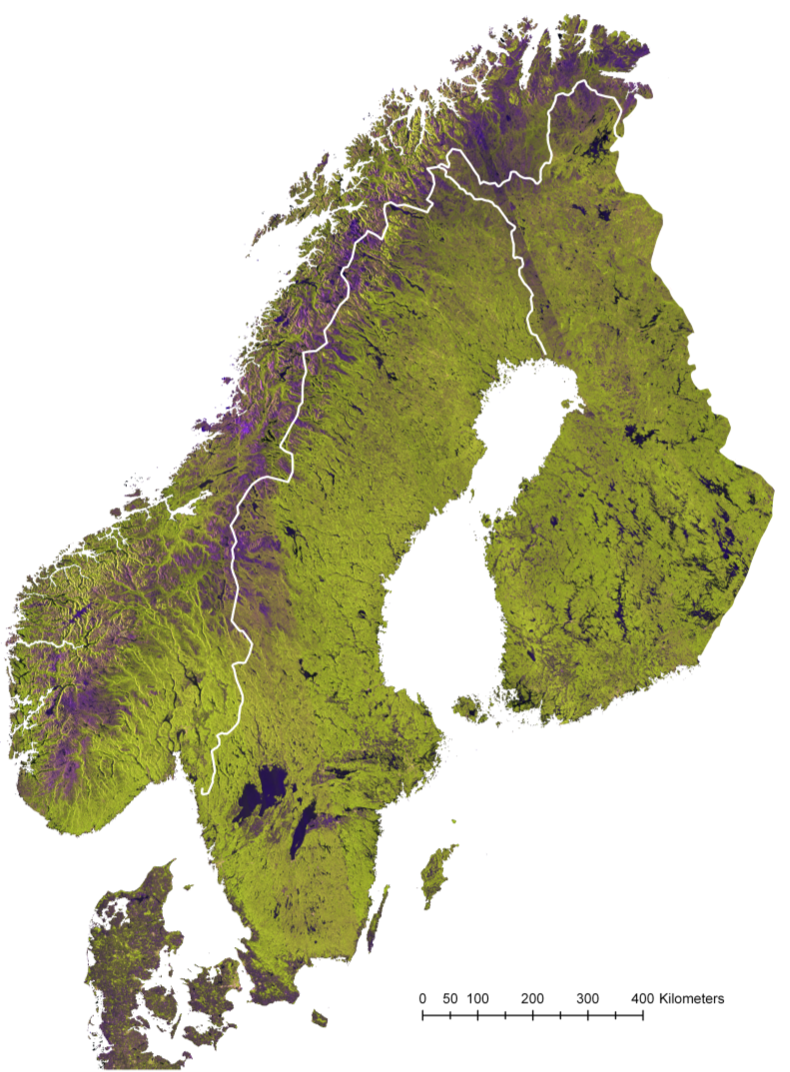
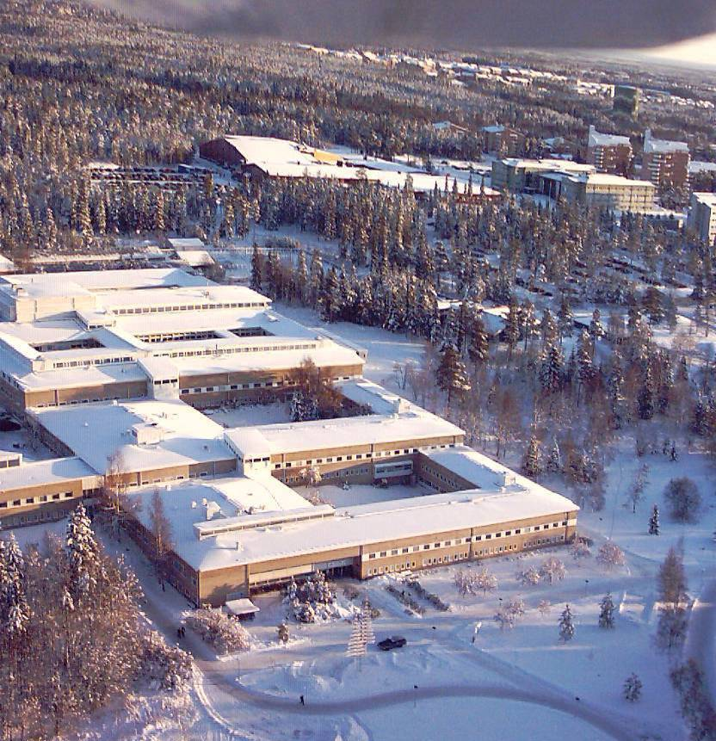

Faculty of
Forest Sciences
SLU
Umeå
Finland
Sweden

Slide 3
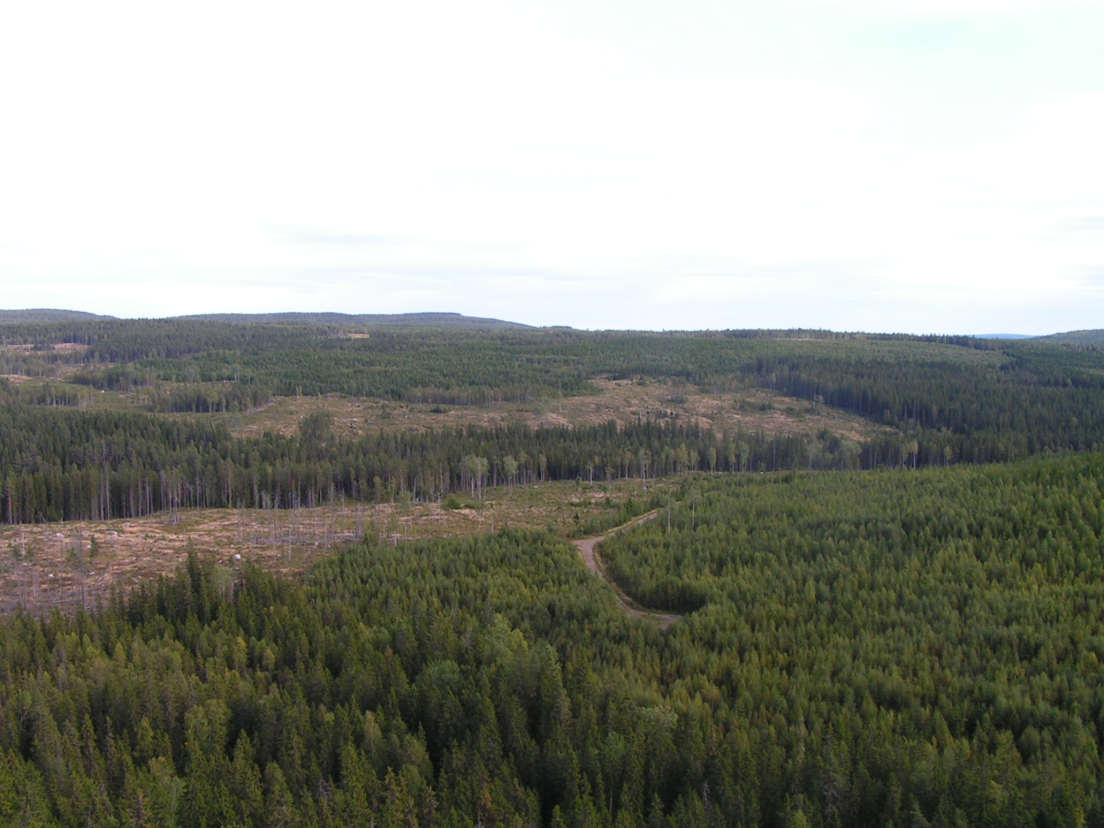
The Swedish land area is 41 million ha
- half of the land area is used for forest production
- half of the forest land is owned by industry and institutions,
- the other half by > 300 000 private forest owners.
Species: 40% Pine, 40% Spruce, 20% Deciduous.
Managed by clearfelling after 80 – 100 years.
Photo from the forest company Bergvik

Slide 4
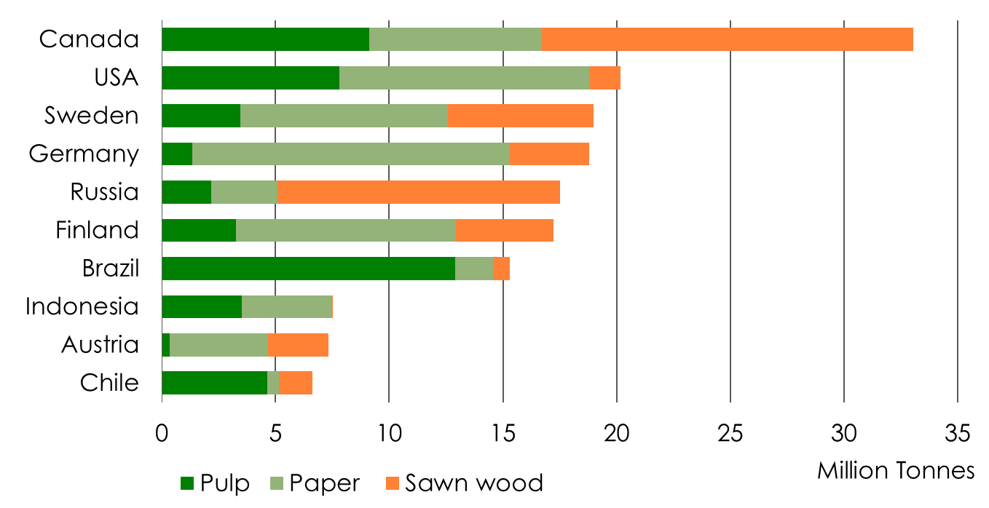
World Leading Exporters 2016
Pulp, Paper and Sawn Timber
Source: Swedish Forest Industries Federation, CEPI, RISI, FAO, National Associations
Notes:
Sweden is the world’s second largest combined exporter of paper, pulp and sawn wood products.
Exports for sawn wood products have been converted from m³ into tonnes; the factor used is 2 m³= 1 tonnes.
The ranking for the different areas, are as follows:
Pulp: number five after Canada, Brazil, USA and Chile.
Paper: number four after Germany, USA and Finland.
Sawn wood: number three after Canada and Russia.

Slide 5
Outline of talk
Operationally used forest data on grid cell level
Results from single tree level research
Some current research topics

Slide 6
Outline of talk
Operationally used forest data on grid cell level
Three examples of use of grid cell level forest data:
1) Data from laser used in a big forest company
2) National level forest data from laser
3) Use of harvester data on grid cell level

Slide 7
Early history of airborne laser scanning (ALS)
of forests in Sweden
- 1991 First ALS research study
- 2003 First large area (5 000 ha) test
- 2009 Start of first national laser scanning,
primarily for a new digital elevation model
- 2011 Example 1. The company Bergvik decides to
use ALS operationally for:
  - Adjustment of stand borders
  - Prediction of forest data on grid cell level
  - Grid cell level planning of thinning cuttings
20 years

Slide 8
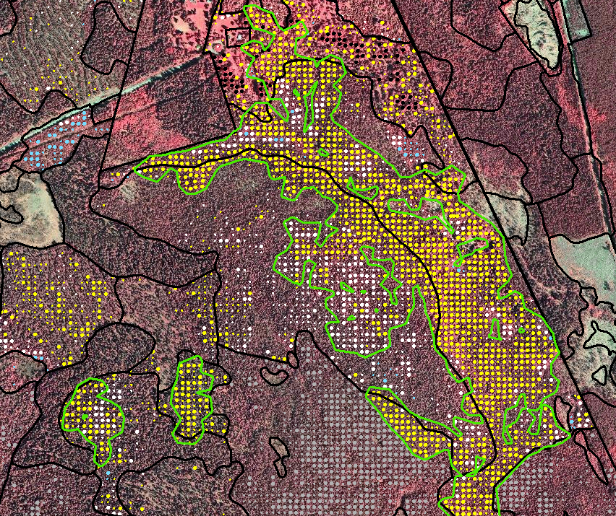
Grid cell level analysis of need for thinning cuttings operational at the company Bergvik since 2011
Yellow dots =
need for thinning
cutting, based on:
- Tree height and basal area from ALS based predictions
- Site index from stand register

Slide 9
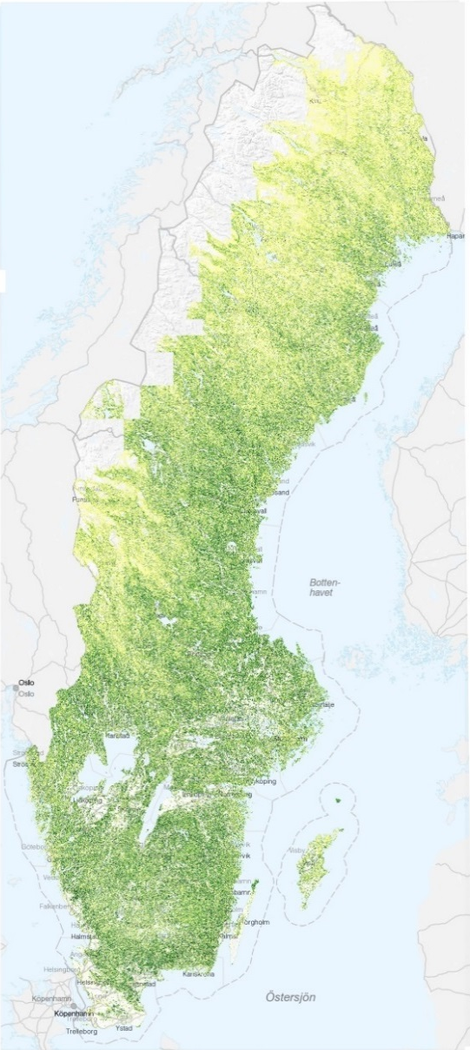
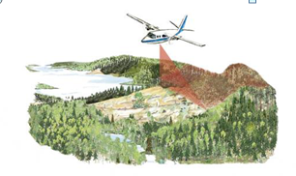
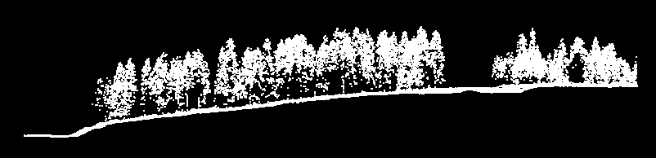
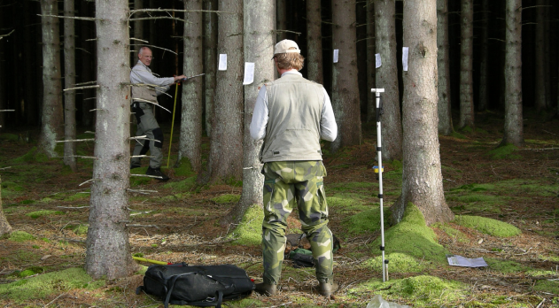



Example 2. A nationwide forest database from ALS
Produced by SLU and the Swedish Forest Agency
2013 - 2015
ALS data from National land survey
$$Y_{i}=β_{0}+ β_{1}X_{i}+ε_{i}$$
Regression analysis
≈10 000 field plots from the
National Forest Inventory (NFI)

Slide 10
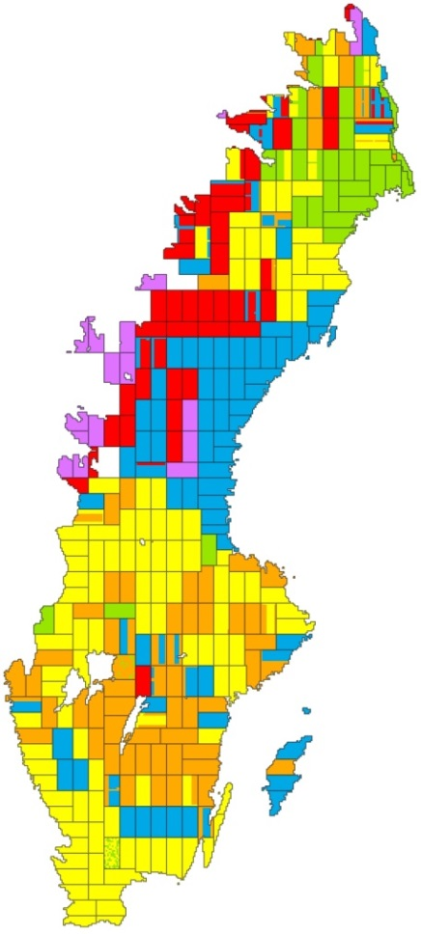
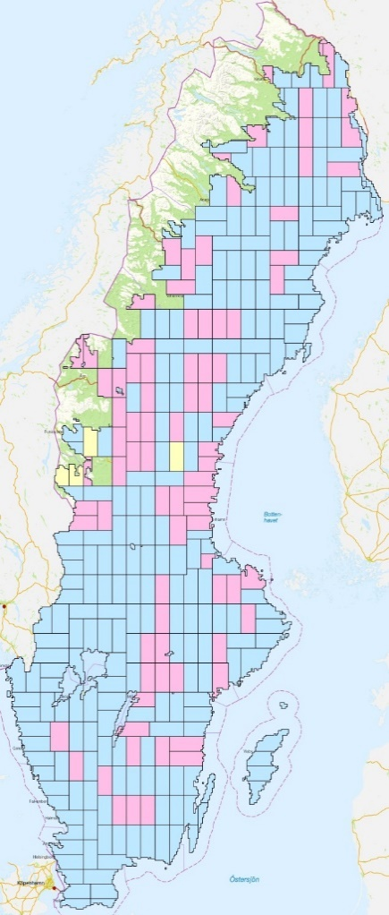
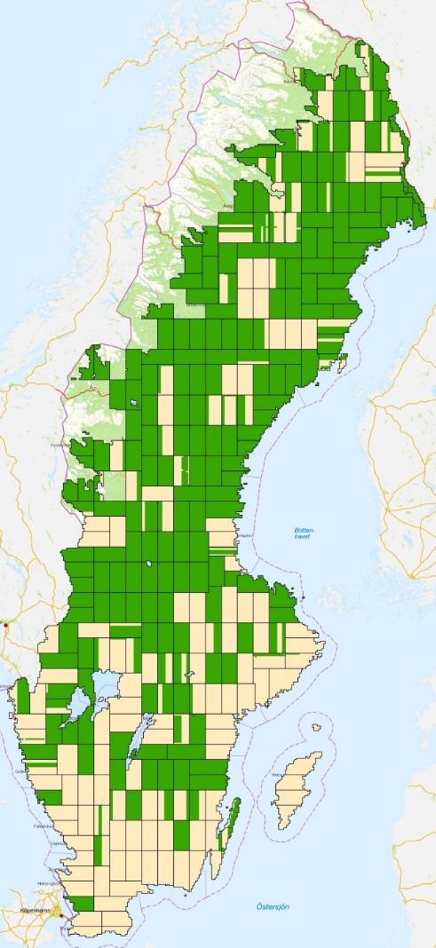
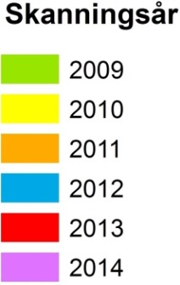
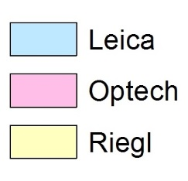
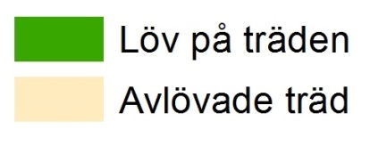
387 laser scanned blocks with size 25 x 50 km from different
years, sensors and seasons → each block estimated separately
Scanning year
Leaf on
Leaf off

Slide 11
Data processing for each 25*50 km block*:
Forecast or back cast NFI data to the year of scanning
Identify 350 nearby NFI plots, max 4 year old,
- in blocks with same scanner type and
- scanned same season of the year (leaf on or off)
- Create raster with laser metrics (Fusion)
Remove outliers (about 15 %)
Estimate linear regression functions
Predict raster with forest variables
* Published in: Nilsson M., et al. 2017.
Remote Sensing of Environment 194:447-454.
Done with
R script

Slide 12
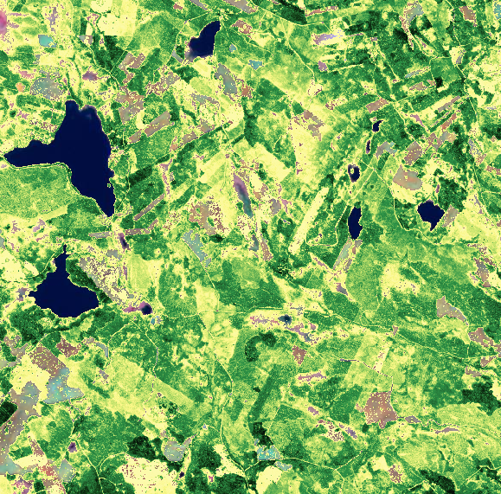
Estimated variables
Mean height
Mean stem diameter
Basal area
Stem volume
Tree biomass
Presented for 12.5 * 12.5 grid cells for all land

Slide 13
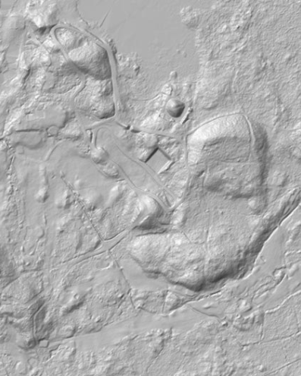
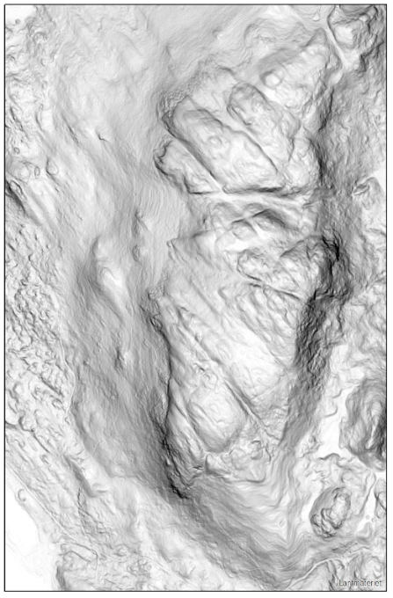
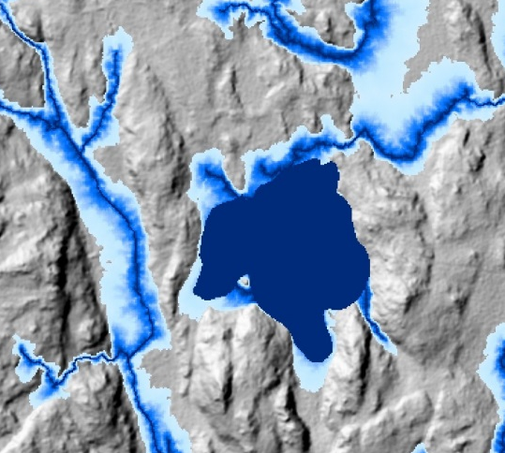
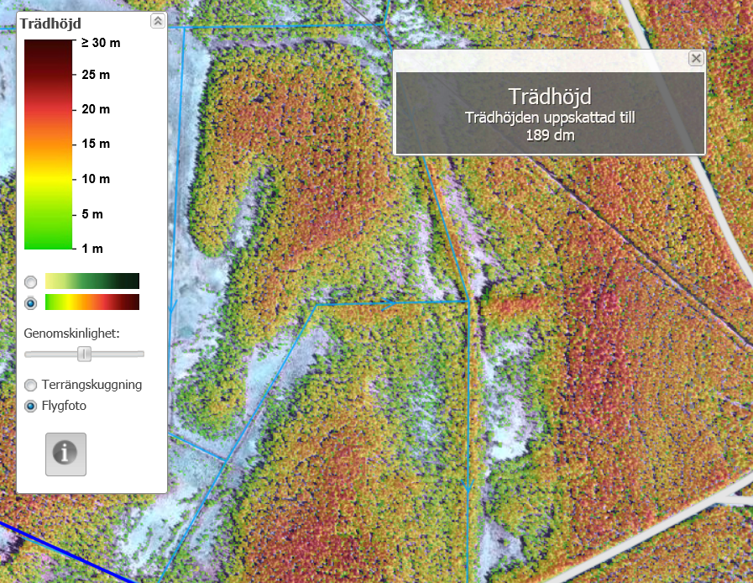
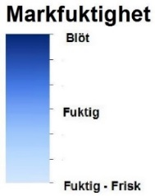
Additional products from laserdata distributed by the Swedish Forest Agency, (but not made by SLU)
Hillshade
Slope map
Depth to water table
2*2 m Canopy height raster

Slide 14
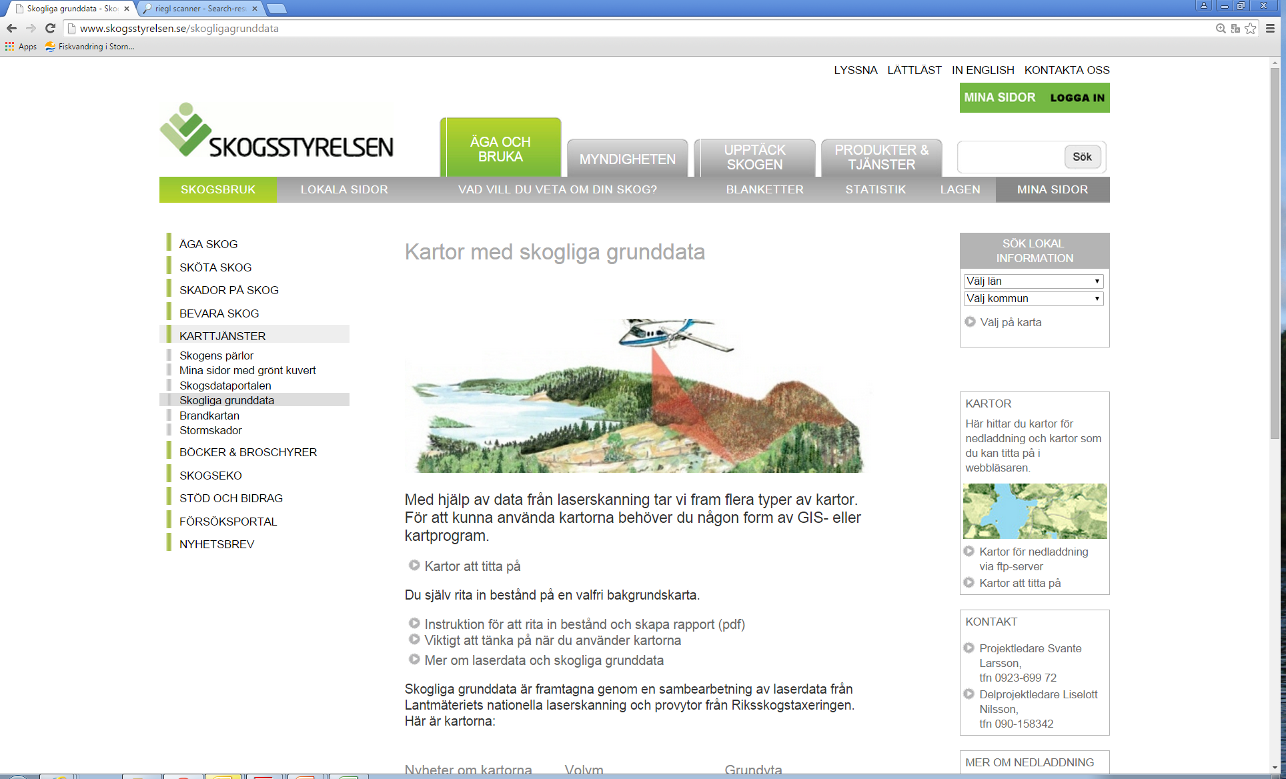
Data are distributed freely over internet under the name
“Skogliga grunddata”

Slide 15
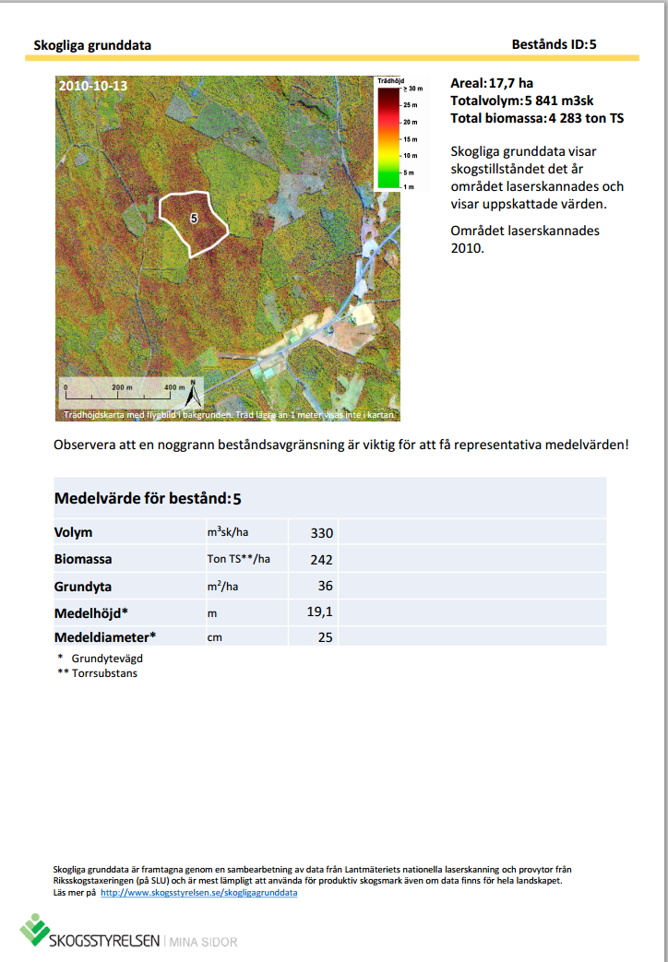
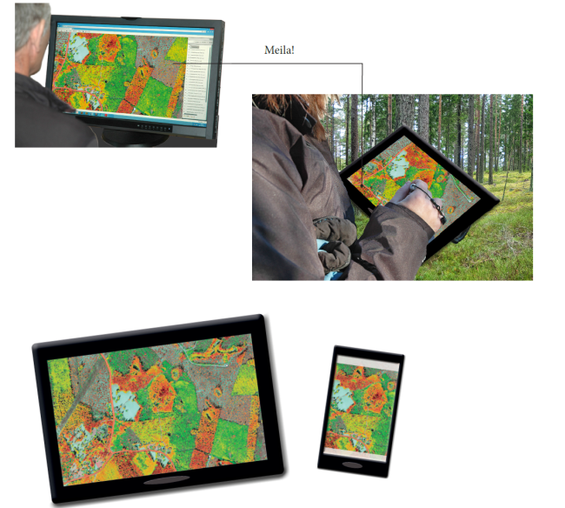
Report generator
and distribution to
smartphones and tablets

Slide 17
Achievements, nationwide forest data base from airborne laser scanner data:
Wall-to-wall area based raster predictions for all forest land in Sweden distributed freely in several ways
The accuracies that the forest owners are used to are generally achieved or exceeded
Cost effective due to use of existing laser data and field data
Due to the success of this project,
a new national laser scanning will start this year!

Slide 18
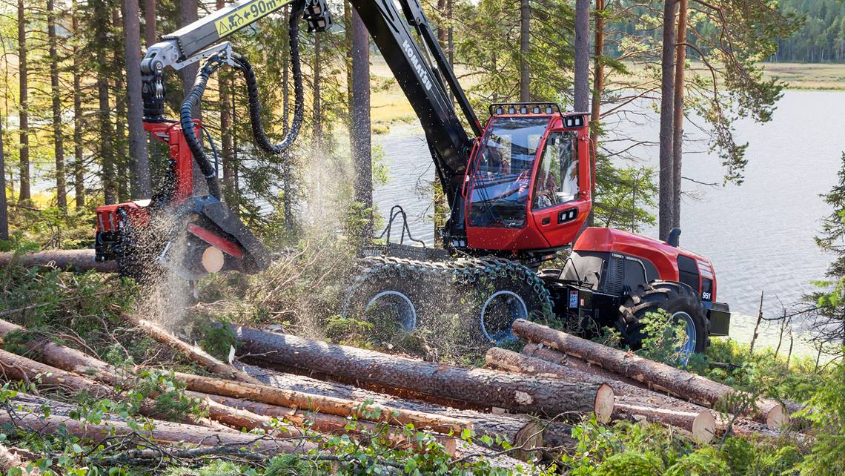
Example 3. Grid cell level forest inventory by using bucking data from the harvesters computer
Image from Komatsu forest in Umeå

Slide 19
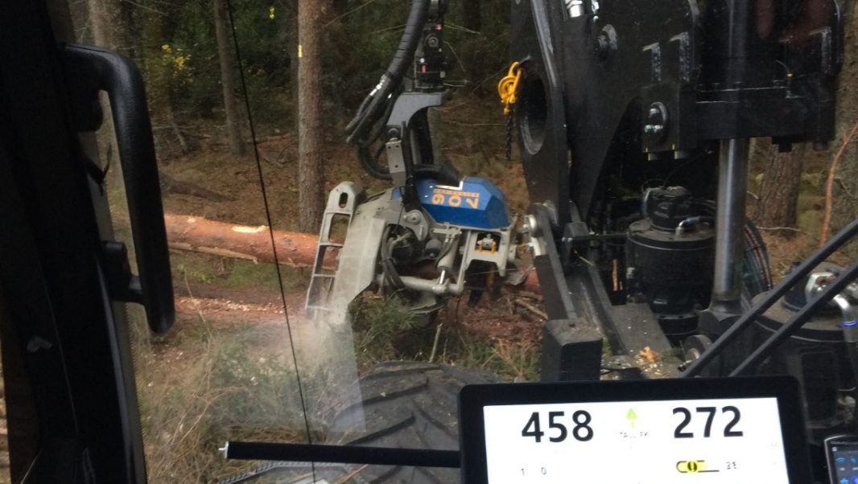

The Forest Research Institute of Sweden has developed
the StanForD 2010 standard for harvester data*
Tree | Species | DBH | X | Y | Bio adapted
1 | Spruce | 330 | 6347115 | 1481603 | 1
Tree | Log | Assortement | Top diameter | Mid diameter | Length
1 | 1 | Saw timber | 271 | 302 | 553
1 | 2 | Saw timber | 233 | 252 | 432
1 | 3 | Saw timber | 196 | 212 | 512
1 | 4 | Small timbr | 165 | 178 | 342
1 | 5 | Pulp | 95 | 132 | 491
*Contact person: johan.moller@skogforsk.se

Slide 20
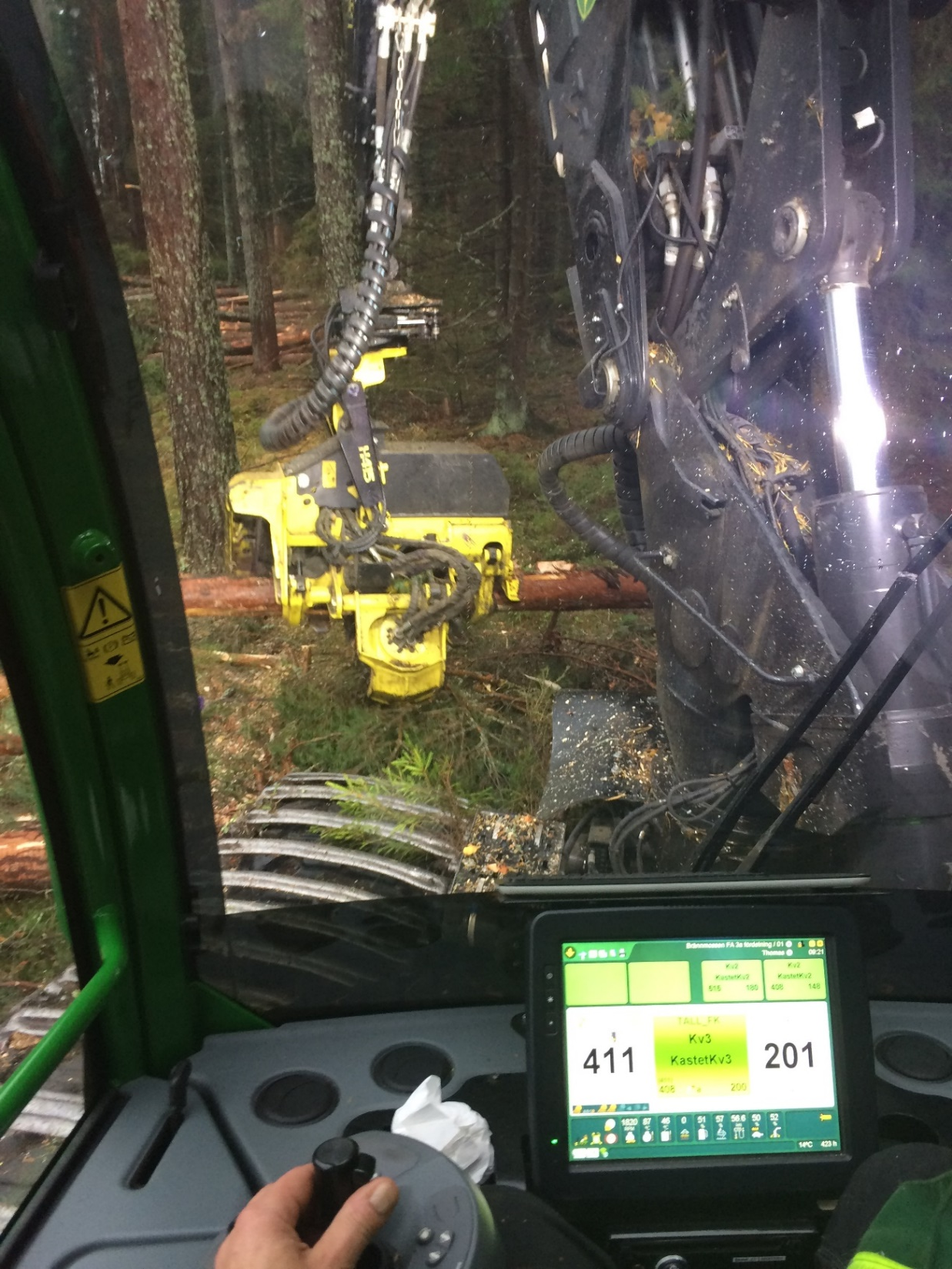
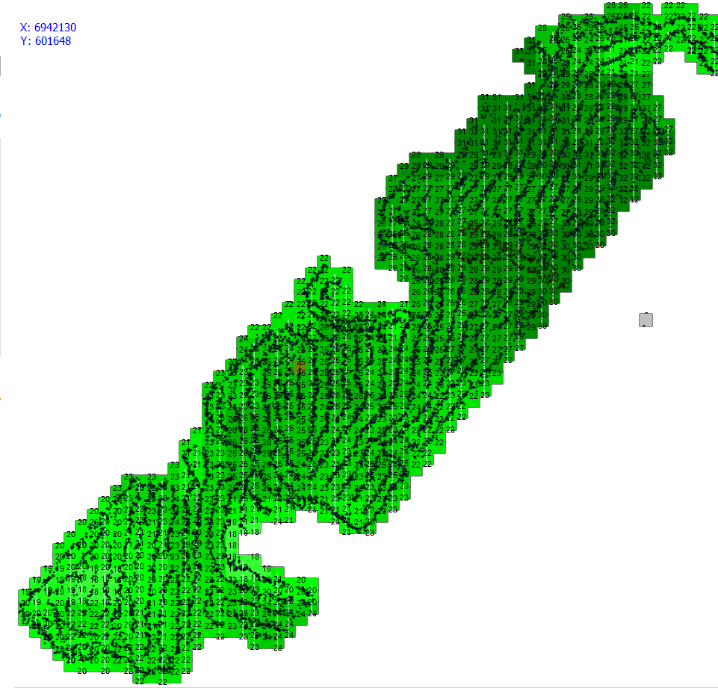
Height map
for harvested
trees,
13 x 13 m
grid cells
20

Slide 21
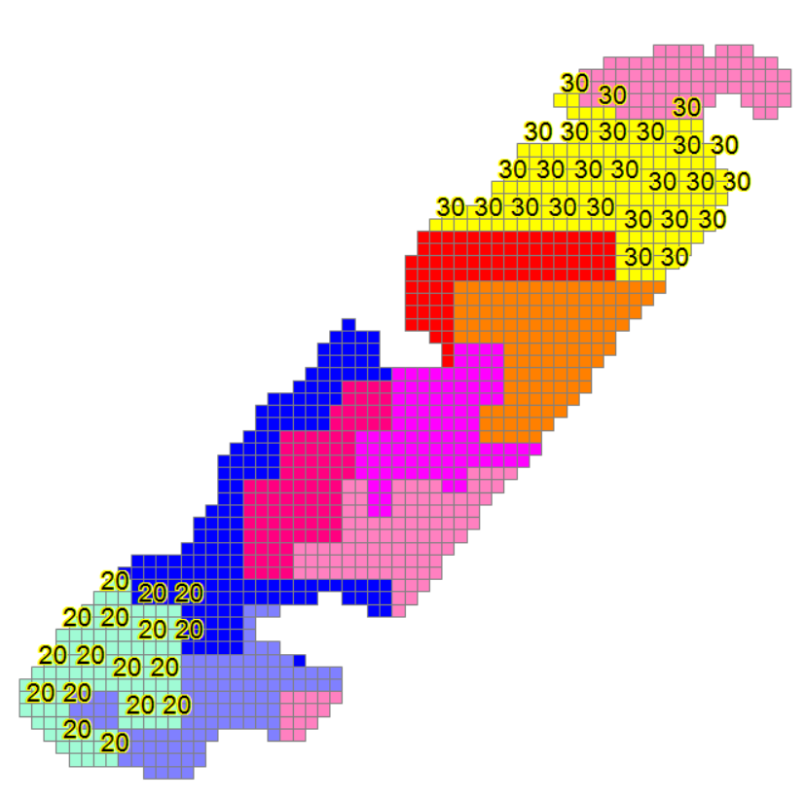


Basal area map from harvester data
Also other variables such as:
- Stem diameters
- Tree species
- Damaged trees
- Proportion timber
and pulpwood
can be predicted.
Image from the Forest research institute of Sweden

Slide 22
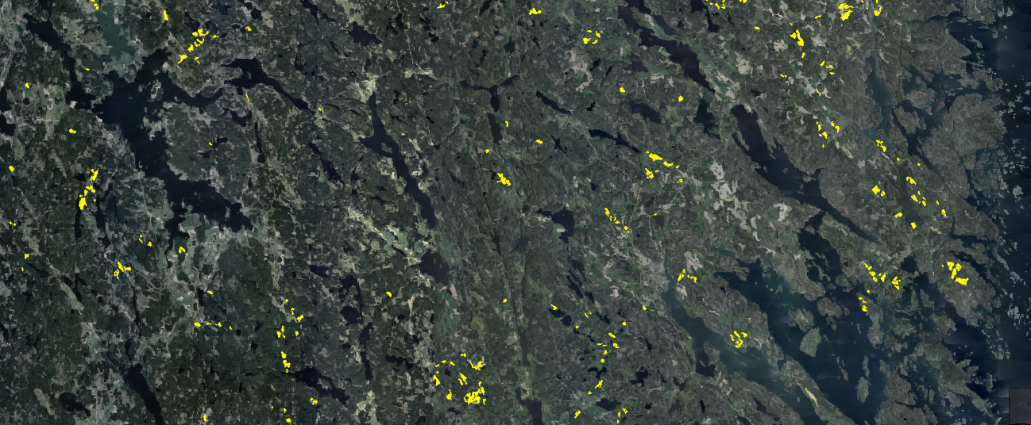
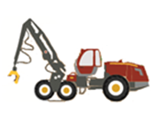

Forest data from several harvested stands
Wall-to-wall laser scanner data used as
carrier data in imputation
Forest data for similar stands that are candidates for harvesting
Modified from Forest Research Institute of Sweden

Slide 23
Outline of talk
Operationally used forest data on grid cell level
Results from single tree level research
Some current research topics

Slide 24
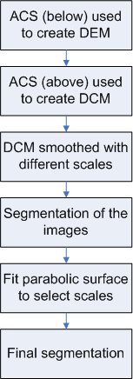
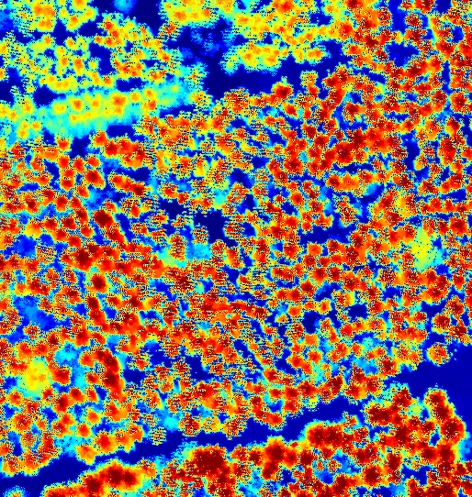
Tree crown segmentation with combination of scales
Persson, Å., Holmgren, J. and Söderman, U. 2002. Detecting and measuring individual trees using an airborne laser scanner. Photogrammetric Engineering and Remote Sensing, 68: 925-932.

Slide 25

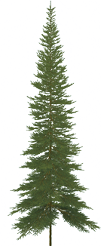
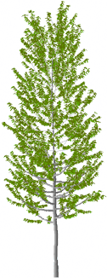
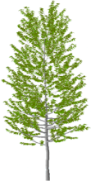
Number of trees | Detected trees with stem diameter
 | >5 cm | >10 cm | >15 cm | >20 cm
795 | 71% | 79% | 86% | 90%

Slide 26
Estimation of variables for individual trees
(Persson et al. 2002) :
Variable | RMSE
Tree height | 0.6 m
Crown diameter | 0.6 m
Stem diameter | 3.8 cm
Stem volume | 0.21 m³

Slide 27
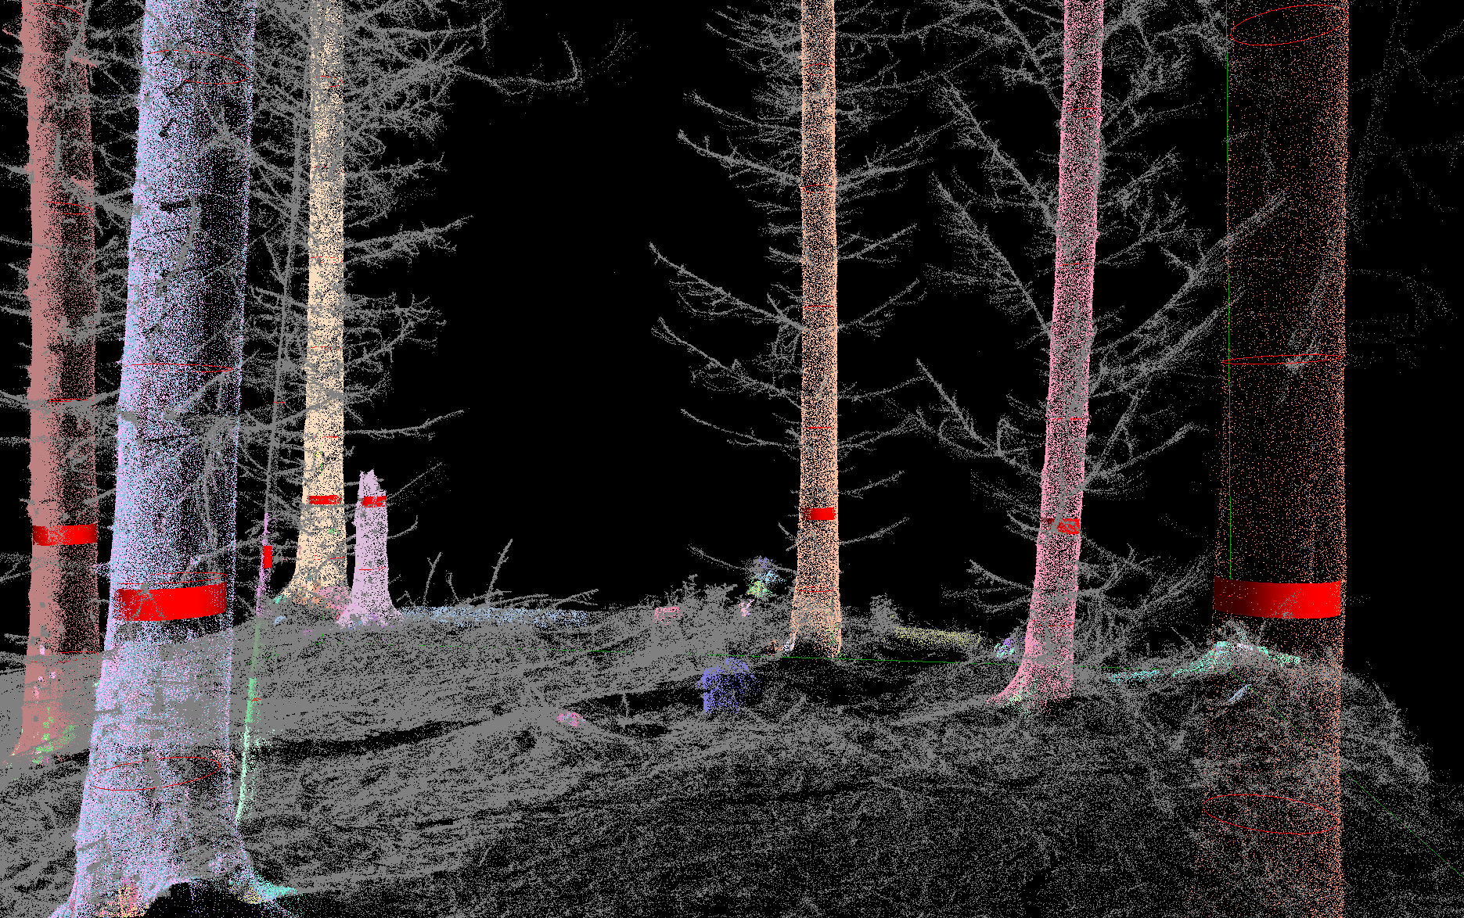
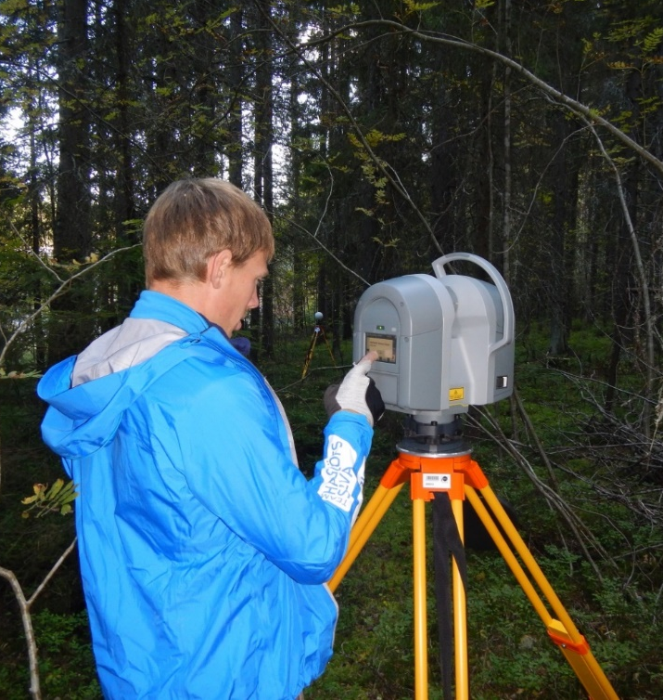
Automated detection of stem diameters using stationary terrestrial laser scanning

Slide 28
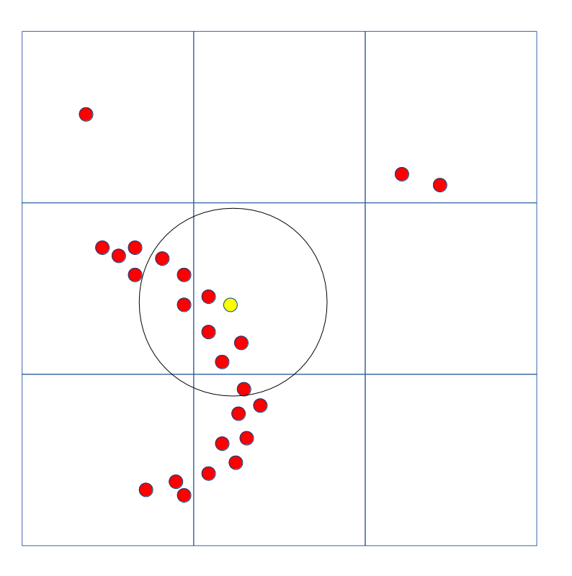
Calculate flatness for small groups of points by applying principal component analysis

Slide 29
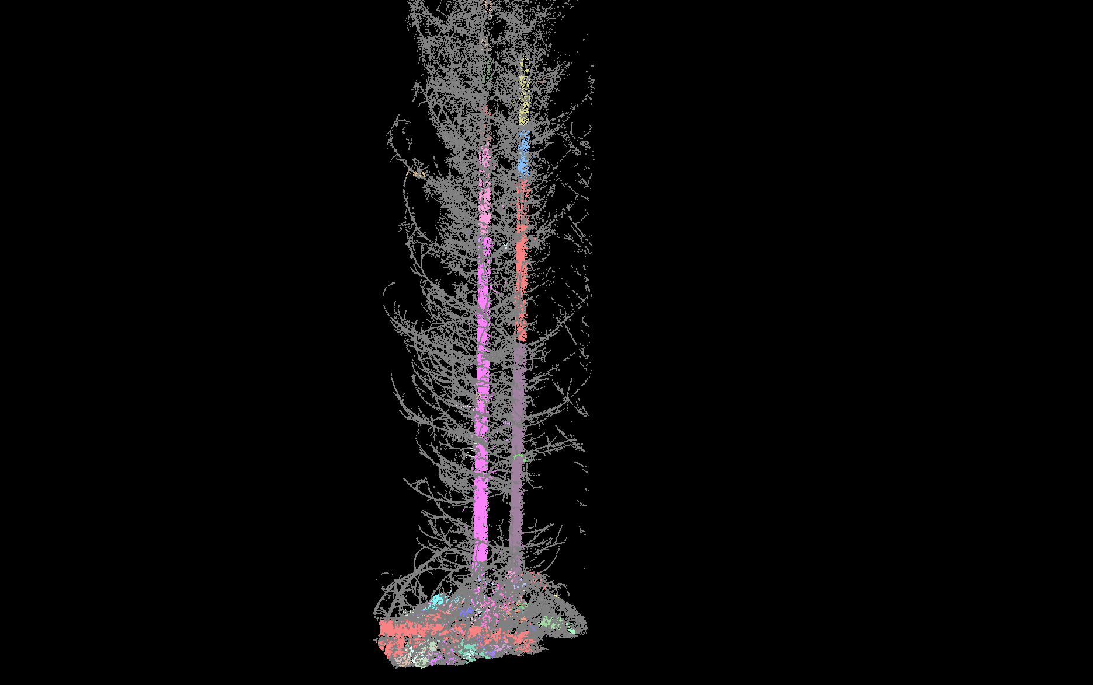

Slide 30
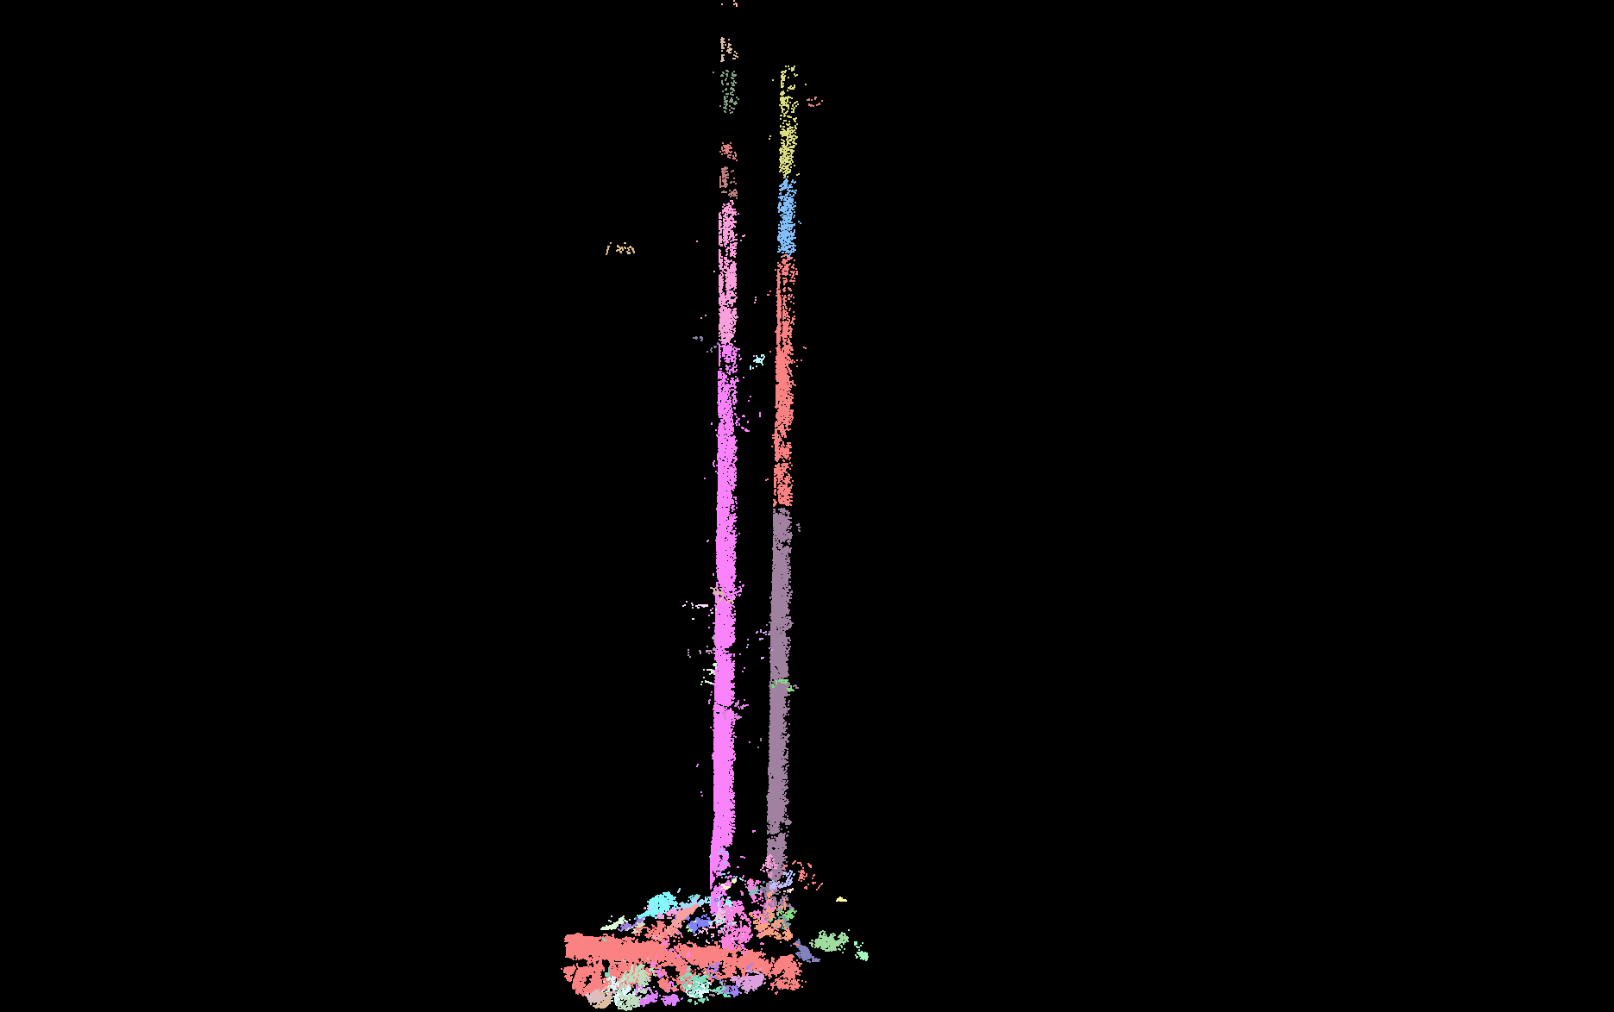

Slide 31
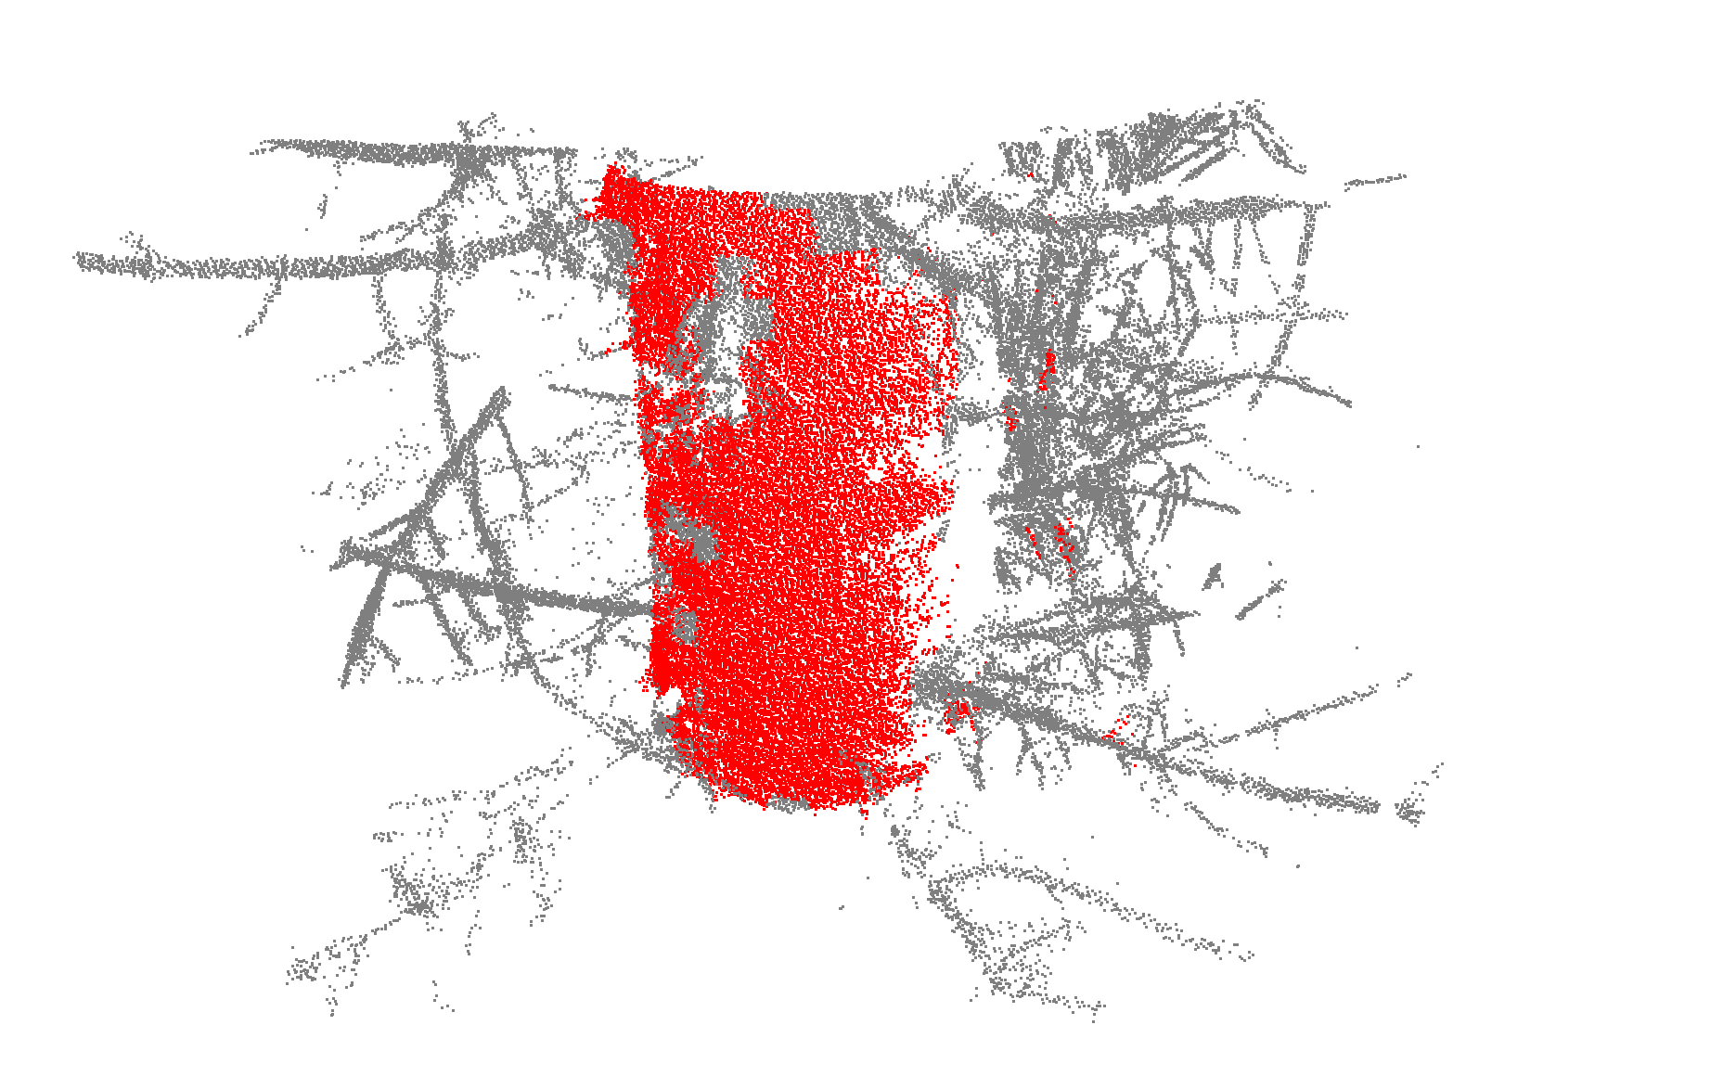
Model cylinders to the classified point data

Slide 32


Slide 33
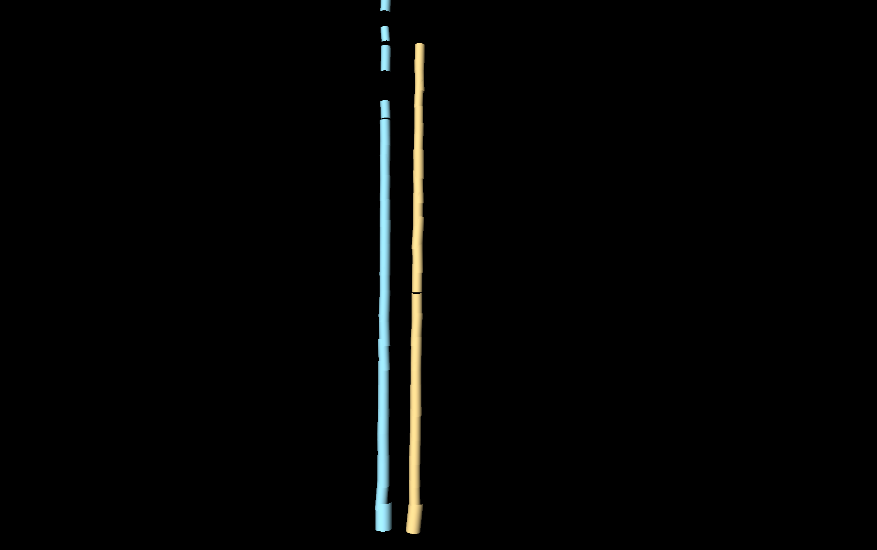

Slide 34
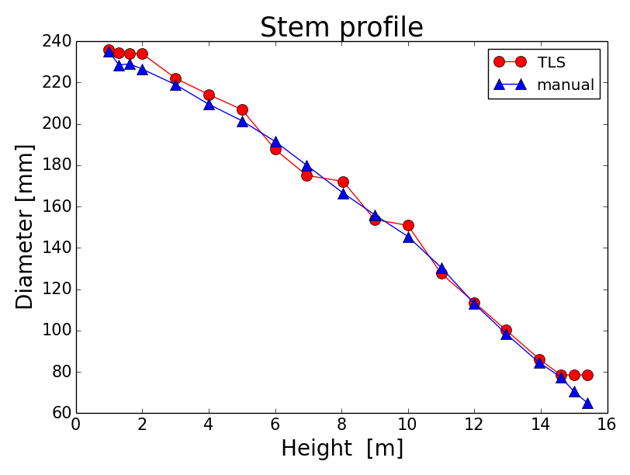
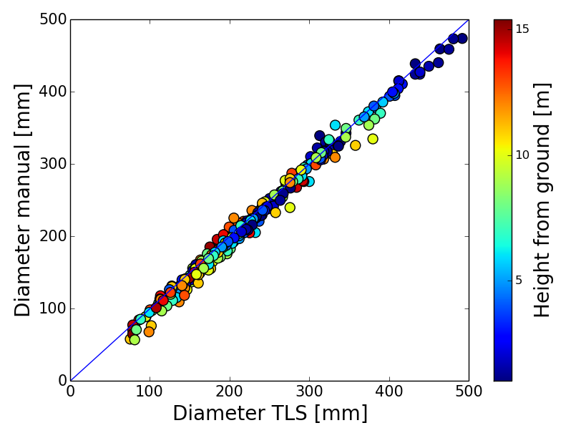
Results för stem profile estimation with multiscan terrestrial laser scanning
Example of profile for a single tree
Result for all trees and heights along the stems ≈ 1 cm RMSE
From: Olofsson K and Holmgren J
2016. Forests 7, 207.

Slide 35
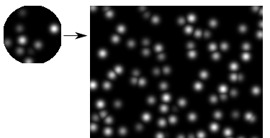
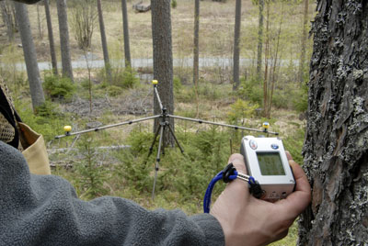
Tree level matching of plots with field surveyed tree positions and single tree level wall-to-wall laser scanning data
Spatial
matching
Tree positions from field
Tree positions from airborne
laser scanning (ALS)
Field source for stem positions Reference publication for matching with ALS
- Manually surveyed field plots Olofsson et al. Proceedings Silvilaser 2008.
- Harvester data Holmgren et al. 2012. Silva Fennica 46:227-239
- Terrestrial laser scanning Lindberg et al. 2012. European Journal of forest research 131:1917-1931.
- Mobile laser scanning Work in progress!

Slide 36
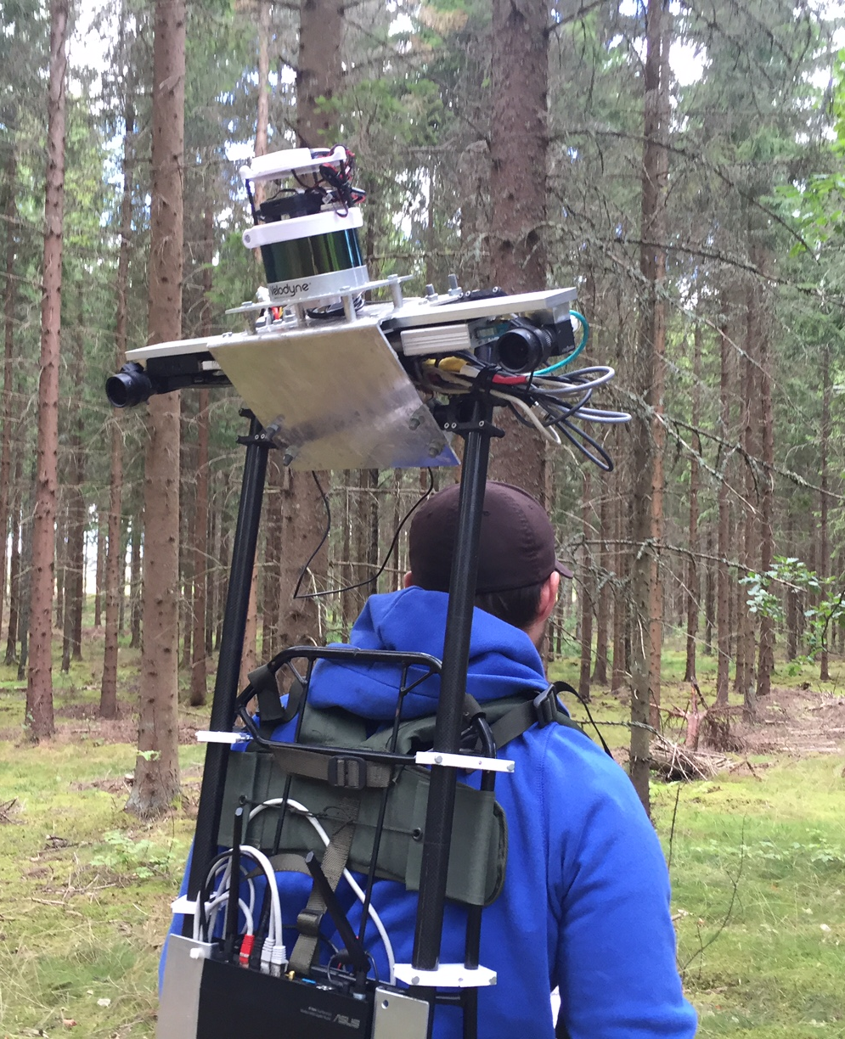
Experimental mobile
Laser scanning system
Sensor components:
Laser scanner: Velodyne VLP-16
Approx. 300 000 measurements / s
Scanning 360 degrees horizontal
Scanning 16 planes ± 15 degrees
from scanner’s vertical level
10 revolutions / second
Visual SLAM system: Chameleon (FOI)
Two Point Grey “Blackfly” cameras
Xsense IMU
Hardware costs ≈ 10 000 USD
Stem diameter accuracy ≈ 2 cm RMSE
Reference: Holmgren et al. 2017. https://www.int-arch-photogramm-remote-sens-spatial-inf-sci.net/XLII-3-W3/59/

Slide 37
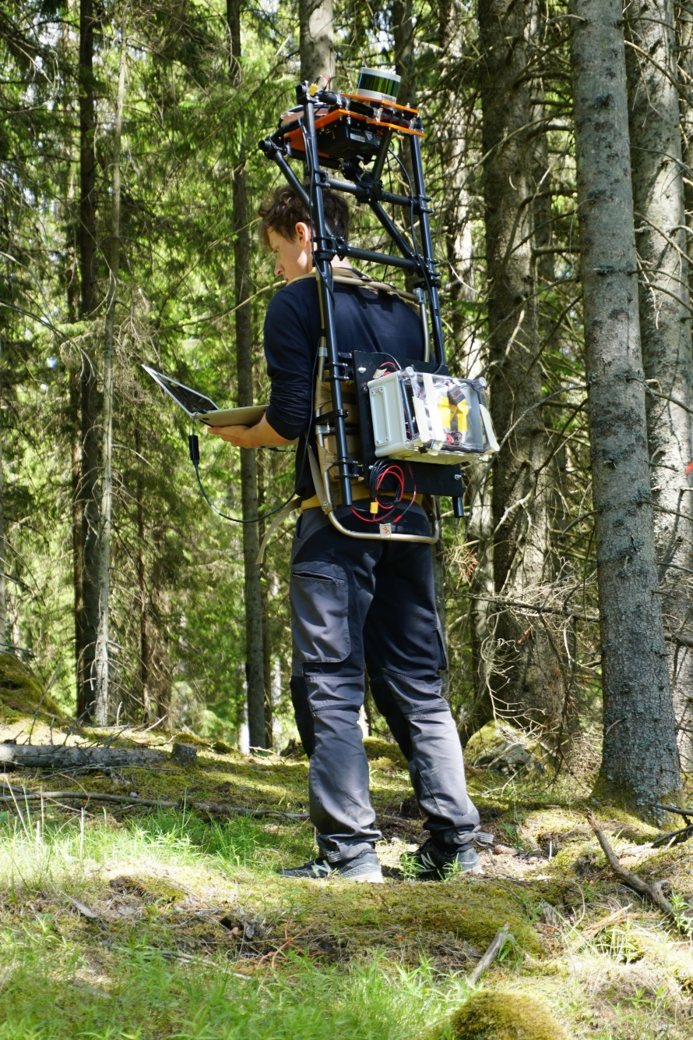
Experimental mobile
Laser scanning system
Version 2
17 000 USD Inertial navigation system
No visual slam

Slide 38
Outline of talk
Operationally used forest data on grid cell level
Results from single tree level research
Some current research topics

Slide 39
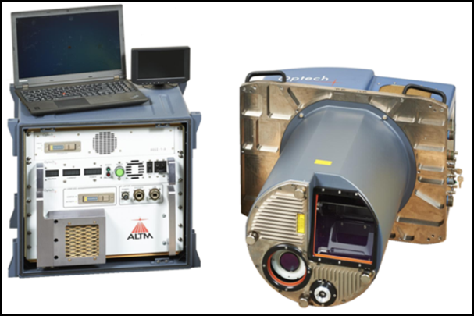
Classification of tree species with multispectral laser
Classification of 9 tree species with the Optec Titan multispectral laser scanner. Cross validated overall accuracies for manually delinated trees.
 | 532 + 1064 + 1550 nm | 1064 nm
Laser intensity metrics from top of canopy | 76.0% | 68%
Canopy structure metrics | 41.3% | 36%
Both reflectance and structure metrics | 76.5% | 66%
From: Axelsson A. et al., 2018.
Remote Sensing 10, 183

Slide 40








Site index and stand age are two related and missing
variables in current laser products
2009
Use of time series of canopy height data might be a solution
DSMs from air photos
1962

Slide 41

Data assimilation for providing an updated forest model
Forecasting of growth based on current forest model
When new RS data arrives:
Change detection
Predictions based on useful part of new RS data are combined with the forecasted data using e.g. Kalman filtering.
Ehlers et al. 2013. Can. J. Forest Research
Nyström et al. 2015 Forests
Lindgren et al. 2017 Can J. Remote Sens
Notes:
Förbättringsförslag: Lägga in nån typ av vägning av respektive datakälla/assimilering.

Slide 42

Assimilation of 19 InSAR images
19 different
volume estimates
using InSAR
data
RMSE %
Assimilation using extended kalman filter
and growth function
From Lindgren et al, Forests 2017

Slide 43


Next generation Single Photon Laser (SPL) scanning systems
Leica SPL100
from
3600 m
provides
more
details than
under the canopy
Optech Titan
Linear ALS
from 400 m

Slide 44
Acknowledgements
Arvid Axelsson, Jonas Bohlin, Mikael Egberth, Johan Holmgren, Jonas Jonzen,
Eva Lindberg, Nils Lindgren, Mats Nilsson, Kennet Nyström, Mattias Nyström,
Kenneth Olofsson, Henrik Persson, Karin Nordkvist, Jörgen Wallerman
Swedish University of Agricultural Sciences
Lars Sängstuvall
Bergvik Skog
Svante Larsson
Swedish Forest Agency
Mikael Tulldahl
Swedish Defense Research Institute (FOI)
Johan Möller
The Forest Research Institute of Sweden

Slide 45

Thank you!
Questions?

